Slide 1
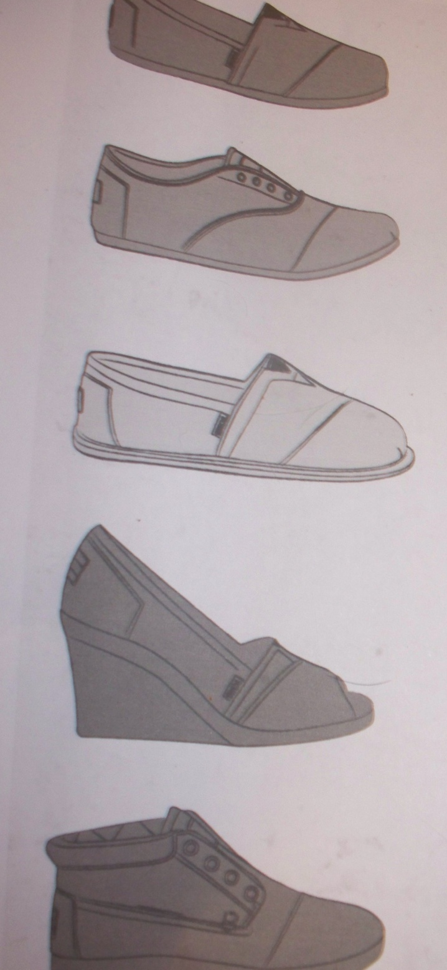
TOMS
By Kory Brown
One for One

Slide 2
TOMS
When many people think of shoes, they usually aren’t thinking of debilitating and disfiguring diseases.
Notes:
Narrator opens up. Camera zooms out to capture the poverty stricken village behind the speaker.

Slide 3
TOMS
But for children in developing countries, shoes are a way to stop life threatening diseases like Pocodonosis.
In many poverty stricken areas, soils have become ridden with bacteria and a disease. So a simple cut or scratch can turn into the loss of a limb or life.
Notes:
Camera focuses on a child in a wheel chair. Speaker continues to talk and walk through village.

Slide 4
TOMS
Families are forced to survive on less than a dollar a day. This leaves no extra money for luxuries like a pair of shoes. In many cases, schools will not allow a child to attend unless they are properly dressed and with shoes.
Notes:
Camera follows narrator through a natives homeand zooms in on children playing barefoot.

Slide 5
TOMS
The Toms family has partnered up with organizations around the world to create the “One for One” Project. For every pair of Toms shoes sold a new pair will be given to a child in need. Toms has worked to establish shoe giving partnerships with humanitarian groups and children who receive these shoes become a part of a larger health and education program to better their young lives.
Notes:
Camera splits to a shot of smiling uniformed school children all wear Toms canvas shoes.

Slide 6
TOMS
Nobody can do everything, but everyone can do something. Be a part of a better tomorrow and give a child the chance to grow.
A pair for a pair. See the difference your pair can make.
Notes:
Narrator comes to a group of children and sits in the middle of them as he speaks. Each child is wearing a pair of black Toms canvas Unisex Shoes.

